Slide 1

Institute Technology of Cambodia
Subject : Data mining
Lecturers : PHAUK Sokkhey and Sophal CHAN
Paper: Predicting Groundwater Areas Using Data Mining
Name chhoem sothy

Slide 2
Outline
About
Object
dataset
Method
Result

Slide 3
About
Topic: Predicting Groundwater Areas Using Data Mining
author: Faisal Aburub and Wael Hadi
Year: 2016
Reference: www.zenodo.org/record/1126459/files/10005377.pdf

Slide 4
Object
proposed a method to check if the ground water from selected areas are potable or not.
Dataset
Data mining techniques have been used to predict for groundwater areas in Jordan and 900 groundwater areas. The groundwater features are: Elevation, Valleys, Slope of the earth's surface, the annual long-term average of rainfall, the annual long-term average of temperatures, Geological outcrop and the faults of earth surface.

Slide 5
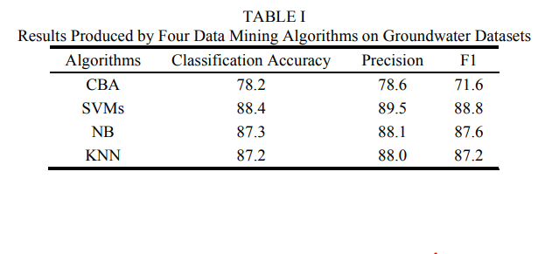
Method
The techniques that use in this paper Classification for prediction.
The dataset is tested and analyzed with five Classification algorithms which are CBA, SVMs, NB and KNN.
Result

Slide 6
Thank You !

